Slide 1
Mobile Applications
Research and discussions on mobile applications development

Slide 2
Hardware
What kind of devices (Hardware) exist currently?
What is a mobile device?
Does it matter geographically?
Research: Find an obscure or uncommon mobile device manufacturer?
What are the common features that define a mobile device?

Slide 3
Software
We all know the common device OS’
How many versions of android exist customised by manufacturers?
Alternative OS available
How do we use our mobile devices?
What kind of apps are used most commonly, what style of app are they? (Social, productivity, information, games etc)

Slide 4
Mobile Development
Languages:
What languages are available to develop on?
iOS / Android – What are the native/recommended Languages for development?
Alternatives? – How do we develop an app in those languages?
Frameworks!
Cross platform development

Slide 5
What is Cross Platform Development?
Cross platform – Deploying the same shared code that’s translated into the appropriate library for each OS.
Benefits:
Quicker development to deployment time.
Common language between versions.
Updates can be made quicker.
Drawbacks:
Reliance on framework being updated/up-to-date.
Extra layer of obfuscation
What options are there for cross platform development?

Slide 6
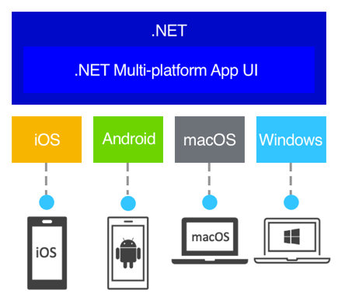
MAUI
Model

